Slide 1
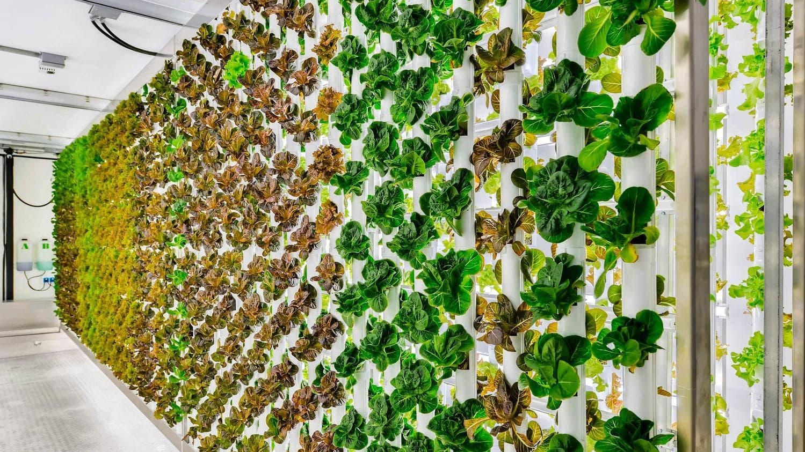
MACHINE LEARNING MODEL FOR IOT BASED DOMESTIC VERTICAL FARMING
Bhashini Alwis (Reg 256)

Slide 2
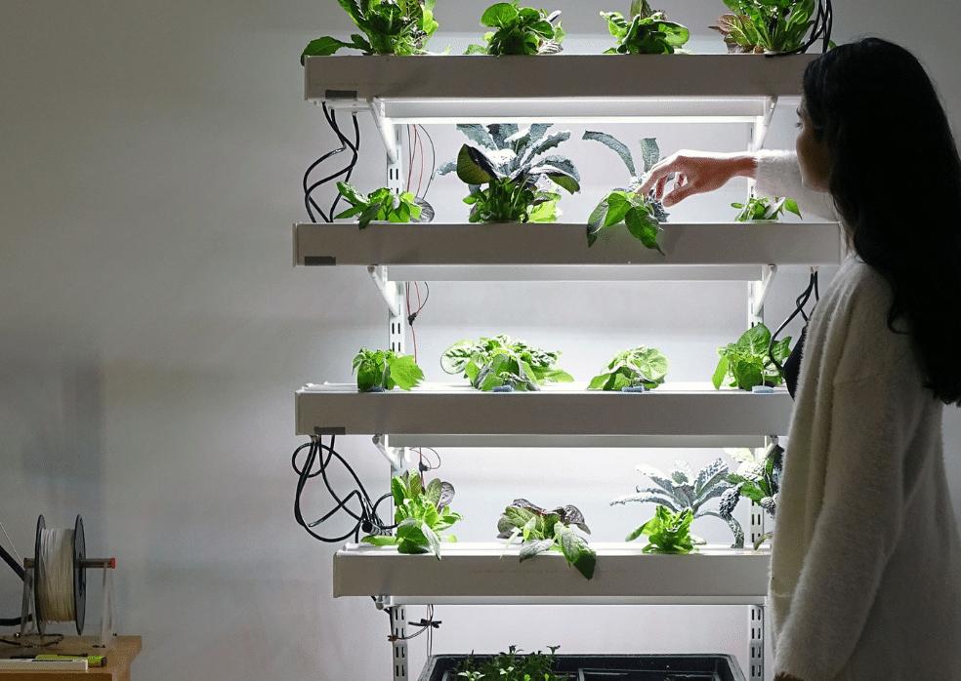
Problem Statement
With the spread of Covid-19 and the quarantine situation faced by countries, normal food-related practices are influenced.
Homemade farming is a challenging practice for people leading a busy lifestyle.
Vertical farming is an innovative solution. In that scenario plant health is a major factor to consider.

Slide 3
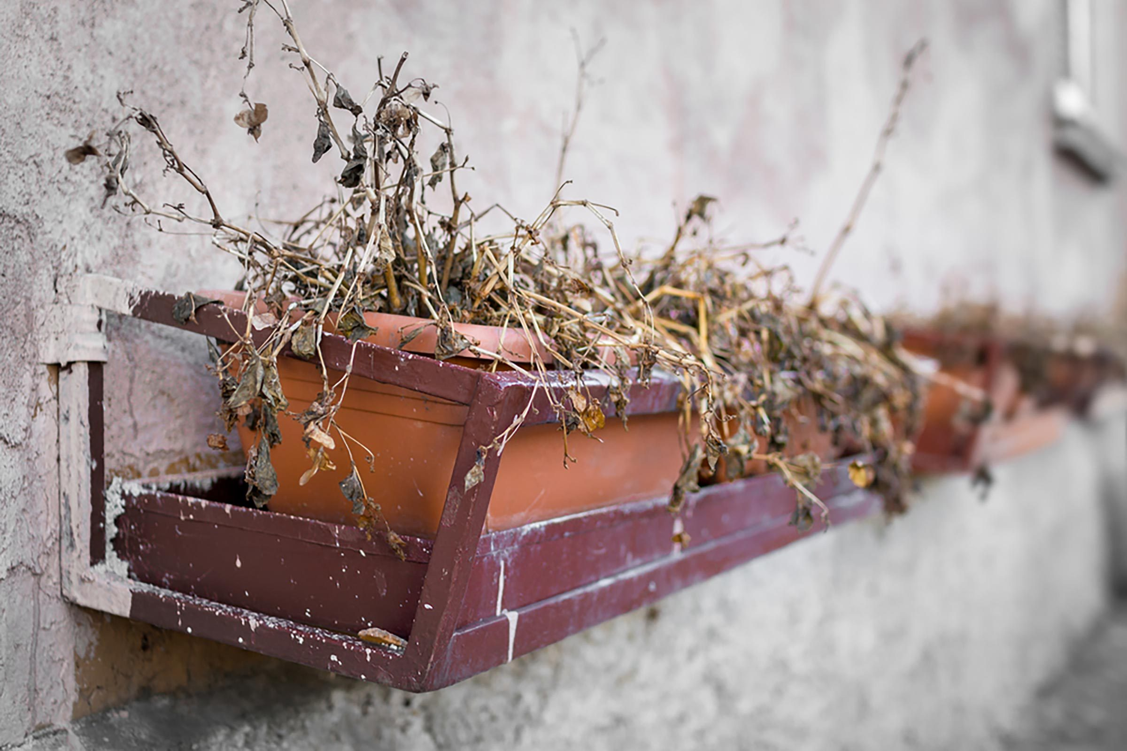
Solution
Amidst the busy lifestyles, the constant check-in of the plant’s health will be an absolute hassle.
Hence the use of a machine learning model to identify if the plant is healthy or not is the main objective of the solution.

Slide 4

Project overview
This model uses linear regression which is a supervised Machine Learning technique.
It is used to forecast values within a continuous range rather than trying to categorize them.
There are two models developed,
To predict temperature & pH value
To predict the future of the crop

Slide 5

Libraries Used
Tenserflow: Numerical computation
Numpy: Numerical calculations
Matplot: Data resonation data time for time manipulation
Pandas: Data structurers
Keras: Control training
Sklearn: Linear model

Slide 6

Temperature prediction
The libraries that were imported in this model are,
Pandas
Numpy
Sklearn
The mock data are fed into the ML model to train and predict.
Then it’s split into four selections to test the data

Slide 7
Crop Prediction Model
For this model it can separate into 3 main parts
Data Pre-Processing
The libraries were imported
The training set was shaped
A scalar was set up
Create a Model Training
ML model was defined
Set up training model
Make Future Predictions
Define a table using Pandas
Visualize

Slide 8
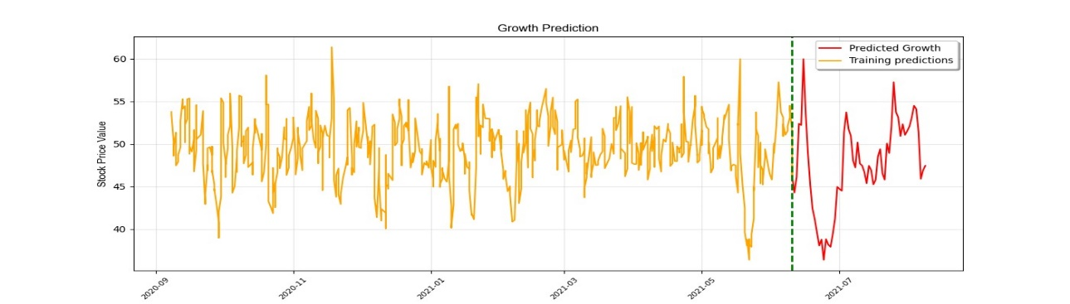
Result
The result of the crop prediction Machine Learning model is giving prediction graph according to the dataset

Slide 9
Thank you!

